Slide 1

New Data scientist candidate exploration
Annelise Lobo
August 6th, 2023

Slide 2
Analysis Factors in determining a well-suited candidate
A full-time data scientist needs to be sought out for our company. This presentation will walk through the following points and provide analysis for each category on the most suitable candidate for the position available. A final walk-through summary of potential salary ranges will be provided to close the analyses
Candidate’s Experience Level
Company Current Size and Rapid Expansion Factor
Competitive Market Rates (Time Dependent Trends)
Position Country Location and Remote Flexibility

Slide 3
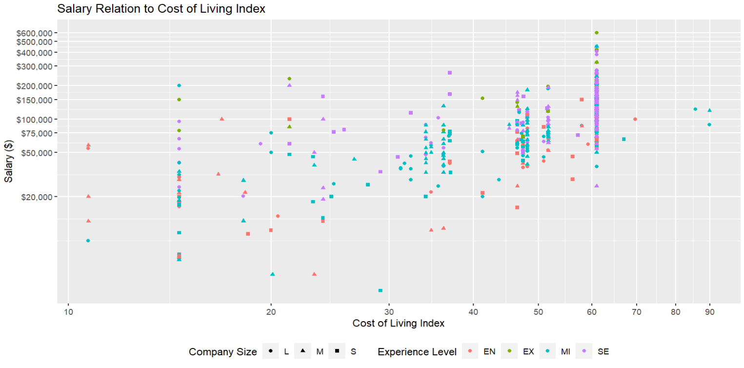
Does Candidate country location matter?
To understand salaries of data scientists in other countries, it is important to know the country’s cost of living
The higher the index, the more expensive it is to live in that country
The US falls at a cost-of-living index of 61
This plot shows all the countries costs of living correlated with their data scientist salaries, separated by the company size and that employee's skill level
The purpose of this correlation is to give a big picture summary of the data that will be examined considering the conclusion that is to come
It is more useful to zero in on specific variables that more closely fit the needs of the company going forward in this analysis

Slide 4
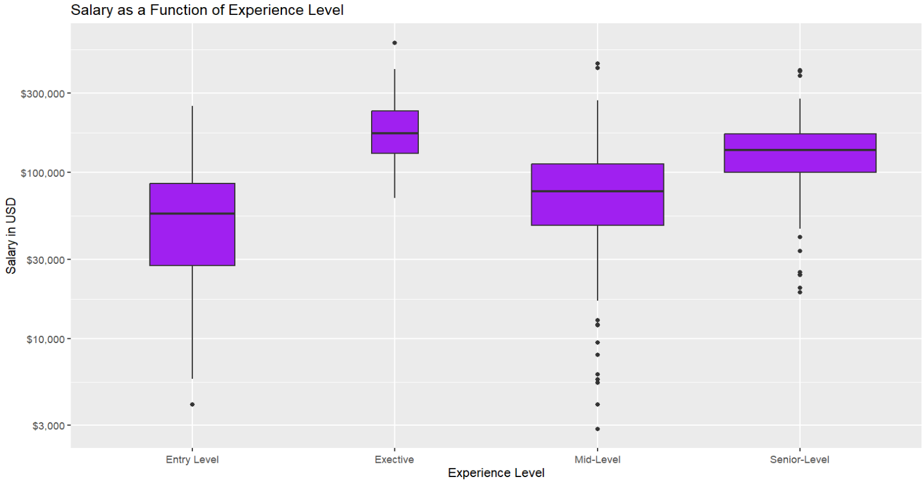
Necessary experience level to fit the role in question
Before the location of the candidate can further be analyzed, it is important to determine what aspects of the candidate can be flexible, and which are fixed
The role for this position indicates a senior level data scientist is needed.
Someone who can drive data science is capable of eventually leading a team
Falling only slightly behind the average salaries of executives, senior level data scientists show a wide range of salaries
The remaining slides in this presentation will help to narrow down this potential range and will look solely at senior-level data scientists
Senior Level Statistical Values
Mean (USD) | $138,617
Range (USD) | $18,907 - $412,000

Slide 5
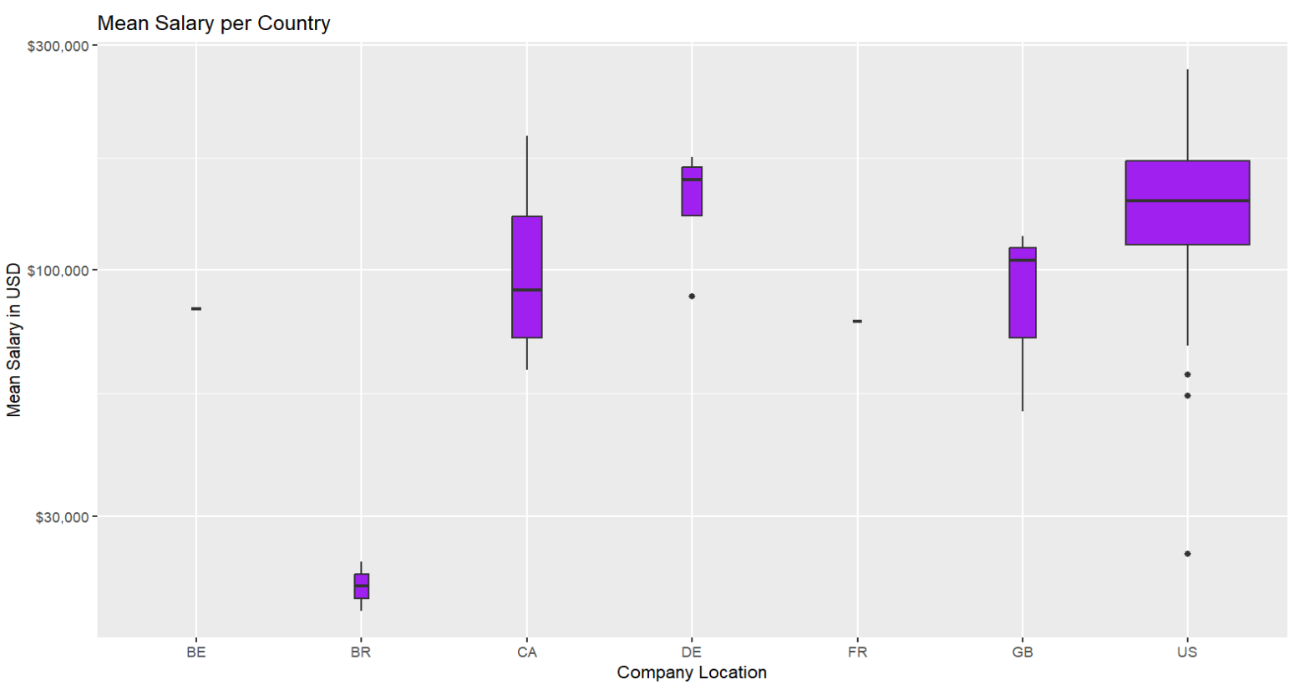
Potential Locations to target Based on specific search criteria
Our company is small, but rapidly expanding. Thus, focus should be on medium and large company salary averages
As afore mentioned, the role should be for a senior level data scientist
This box plot provides a deeper understanding of average salaries based on a senior data scientist in both large and medium companies
The list of countries shown on the x-axis are the most suitable as their cost of living are lower than the US, therefore offering a lower salary than if the candidate was in the US would be more acceptable.
As seen through the width of each box plot, there is little data on salaries for certain countries. Since there is not much data to form conclusions from those countries, it is possible the demand for data scientists there are low and so looking in those areas may take a longer time than necessary
Since times have changed since the COVID pandemic, working overseas for a US based company is not uncommon. Time dependent changes though should be observed when making any decisions
*Countries to consider going forward: Canada (CA), United Kingdom (GB) and United States (US)
**Though Denmark (DE) has a comparatively large number of data points, due to the mean salary being higher than the US, the country will be excluded

Slide 6
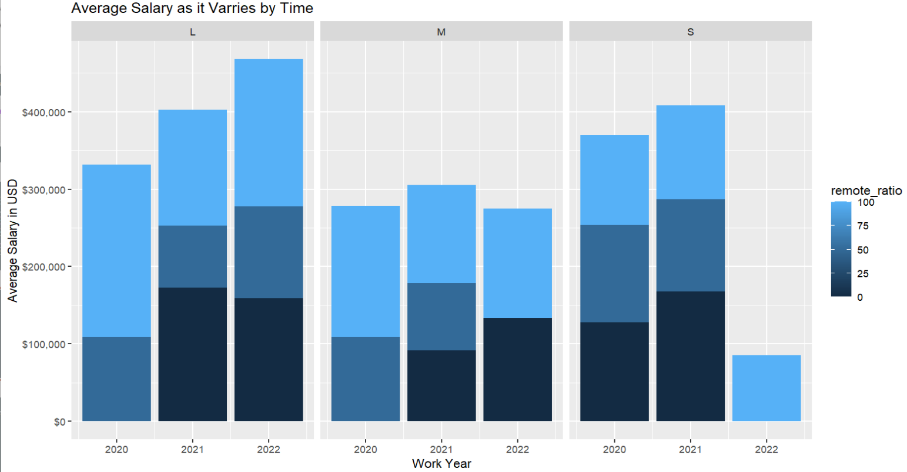
Time related changes in data scientist salaries
The bar plot demonstrates time dependent changes in senior level, full-time data scientist salaries, stacked by their remote ratio
The market may offer competitive salaries, but it effects large scale companies more
From a small company who is growing, salaries may be lower, while still being competitive
Being a small company that is growing, offering a salary within the medium size company averages would be acceptable
From the previous shown relation of location and salary, remote work may be a given if the company decides to offer an overseas candidate the position

Slide 7
Final candidate to offer job to based on the following questions
Candidate location options: Canada (CA), United Kingdom (GB) and United States (US)
Offer salary based on us being a medium size company as we are currently small but expanding
Based on these average salaries for full-time data scientists, a salary with approximately $10k over the average, based on the three different locations, should get a well-fit candidate onboard
Country | Mean
Canada | $104,438
United States | $146,889
United Kingdom | $74,821

